Slide 1
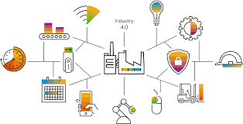
DIPARTIMENTO DI INGEGNERIA ELETTRICA E TECNOLOGIE DELL’INFORMAZIONE
SCUOLA POLITECNICA E DELLE SCIENZE DI BASE
Robotics Lab: Technical Project
Professor: Mario Selvaggio Student: Micol Ricci P38000109

Slide 2

INTRODUCTION:
The goal of the project is to simulate typical application of the Industry 4.0
  An operator using the keyboard asks to take a particular tool among the ones available in the system.
  The mobile robot starts to navigate in the environment and search for the asked tool
  To take a tool, the mobile robot must just look to the landmark contained in a room for 1 second.
After that the tool has been taken, it must be brought to an industrial manipulator placed in a known location of the environment
After reached the manipulator, the industrial robot will simulate to release this tool on a region of its workspace detected using another landmark.
Robotics Lab: Technical Project
Notes:
<numero>

Slide 3
INTRODUCTION:
This project aims to simulate a realistic application in which, within a workshop, there are three rooms that serve as specific object repositories and a workspace room containing a manipulator.
A mobile robot searches for the object requested from the workspace room, retrieves it, and transports it to the manipulator to complete the service.
The kind of tool are described with an AR Marker
To take a tool, the mobile robot must just look to the landmark contained in a room for 1 second.
Another AR marker detect the workspace of the Manipulator
The industrial robot to simulate the release of the tool just bring its end effector closest to the center of the landmark on the ground.
Robotics Lab: Technical Project
Notes:
<numero>

Slide 4
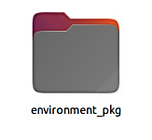
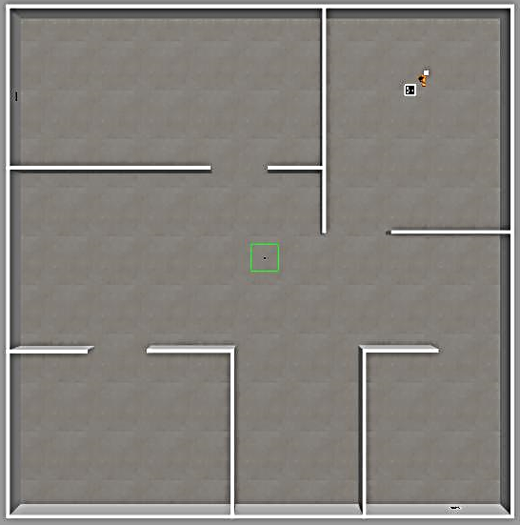



Simulation Scene
The screwdriver is in the 1st room
The scissor is in the 2nd room
The wrench is in the 3rd room
A supplementary marker positioned on the floor, and it corresponds to the region where the industrial manipulator has to release the tool.
1
2
3
multi_robot_environment.world
Robotics Lab: Technical Project
Notes:
<numero>

Slide 5
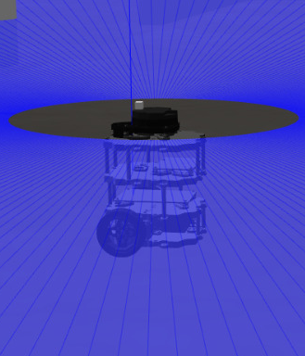
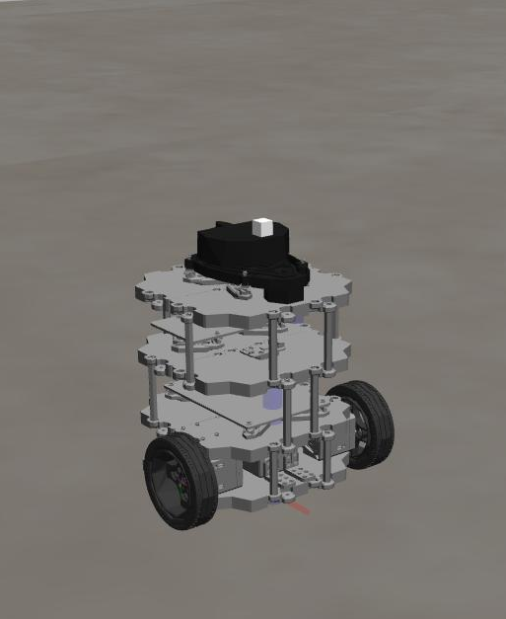
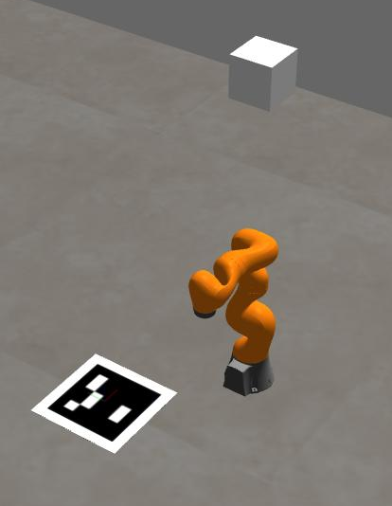
Robots and sensors
Differential drive robot:
Turtlebot3 burger
Equipped with:
  360° lidar for SLAM
  RGB camera for marker detection
Industrial manipulator:
Kuka IIWA
Equipped with a fixed camera
Robotics Lab: Technical Project
Notes:
<numero>

Slide 6
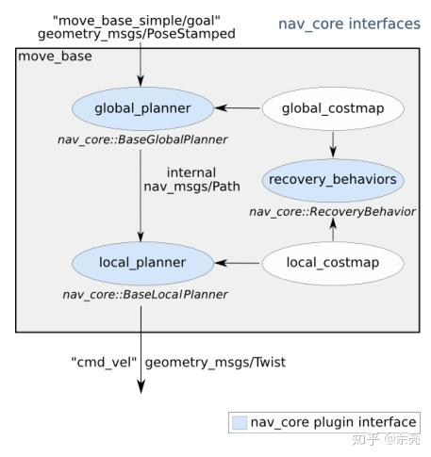
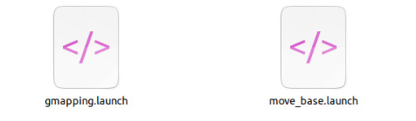
Navigation Nodes:
GMapping is a package that combines simultaneous mapping of the environment (SLAM) and localization of the robot within it. This is crucial for having an accurate map of the environment and knowing the robot's location in real time.
MoveBase is an autonomous navigation package that uses the map created by GMapping to calculate safe routes and guide the robot while avoiding obstacles. This combination provides a complete solution for autonomous navigation
Robotics Lab: Technical Project
Notes:
<numero>

Slide 7
Sistem Architecture
SUBSCRIBED | NODE | PUBLISHED
aruco_marker_publisher
cmd_vel
Turtlebt_controller_node
kuka_sem
aruco_marker_publisher
wall_camera
Eef_pose
kuka_sem
Kuka_controller_node
joint1_pos_controller
.
.
.
Joint_state
joint7_pos_controller
Robotics Lab: Technical Project
Notes:
<numero>

Slide 8
TURLEBOT CONTROL LOOP
The “_mv_base.waitForServer()" call waits for the move_base action server to become available before continuing execution. Once the server is available, the code prints a message to indicate that the connection has been established.
The “ choose_item()” function ask for the tool to pick up.
Once the preferred tool is chosen, the turtlebot will travel to one of three predetermined locations situated in separate rooms of the world. (go_search)
The function then enters a loop that iterates over the rooms and searches for the marker.
For each room, the robot sets a goal for the move_base and sends it to the move_base action server. Once the robot reaches the goal, it rotates to look for the marker. If the marker is detected, the pick _tool () function is called to initiate the tool picking process.
Robotics Lab: Technical Project
Notes:
<numero>

Slide 9
TURLEBOT CONTROL LOOP
In the event that the TurtleBot spots a marker inside a room before reaching the corresponding waypoint, and it turns out not to be the desired one, the mobile robot will skip that room and proceed to the next waypoint.
The subscriber listens to the "/aruco_marker_publisher/markers" topic and calls the “look_for_marker" function of the Turtlebot_controller class whenever a message is received on that topic.
Once the marker is found and the robot reaches the Kuka manipulator, the function sends a signal to the manipulator to start the grasping process.
If the marker is not found, the robot returns to the center of the room and sends a signal to the manipulator that the tool has not been found.
Robotics Lab: Technical Project
Notes:
<numero>

Slide 10
KUKA CONTROL LOOP
Once the manipulator starts up, it locates the delivery point using a fixed camera on top of it, placed such that the x and y coordinates in the camera frame and in the Kuka operational space coincide.
At this point, the Kuka iiwa waits for a signal from the Turtlebot. The manipulator subscribes to a specific ROS topic (kuka_sem) where the Turtlebot will publish the result of its search.
Once the manipulator 'receives' the tool it will direct its end-effector to the center of the marker.
The member function receives the target position and orientation as arguments and sets them as the desired pose. It then computes the inverse kinematics of the arm using the KDL position solver and publishes the desired joint positions to the ROS topics for the position controllers of each joint.
The function waits until the arm reaches the desired pose before returning.
Robotics Lab: Technical Project
Notes:
<numero>

Slide 11
THANK
YOU FOR
YOUR ATTENTION!
Robotics Lab: Technical Project
Notes:
<numero>

